Slide 1
vRSU Cloud Solution 13 Oct 2022

Slide 2
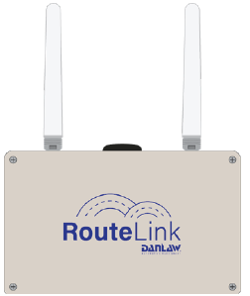
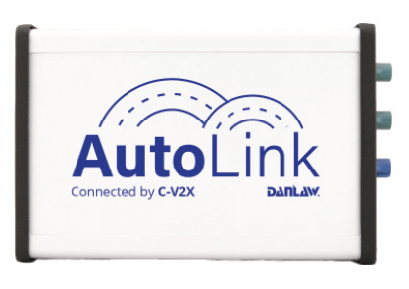
V2X Products
7 years of experience in V2X industry with projects including:
RSU supplier to:
Ohio Department of Transportation
Georgia Department of Transportation
Michigan Department of Transportation
Macomb County Department of Roads
OBU supplier to
New York City Department of Transportation - https://www.its.dot.gov/pilots/pilots_nycdot.htm
Ann Arbor Connected Vehicle Test Environment (AACVTE)- Managed by University of Michigan Transportation Research Institute (UMTRI)- https://aacvte.umtri.umich.edu/
Installations including integration with school and transit buses, light and heavy-duty trucks, cars, snowplows and emergency vehicles

Slide 3
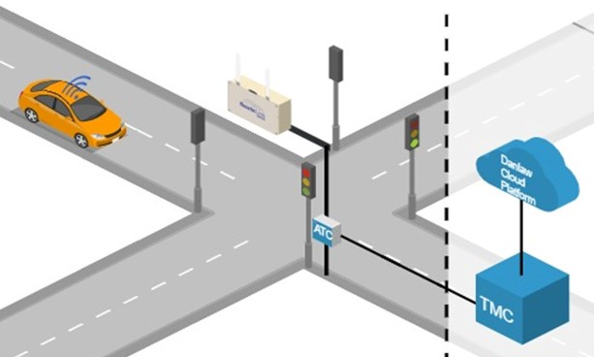
Connected Intersection 5G (or) 4G LTE
TMC – Traffic Management Center
ATC – Advanced Traffic Controller
RSU – Roadside Unit
MAP – Intersection Geometry Message
SPaT – Signal Phase and Timing Message
TMC configures ATC with intersection MAP and SPaT
ATC communicates real time SPaT to RSU
RSU communicates SPaT to the Cloud through the TMC
Vehicle sends its location to the Cloud (over 5G or 4G LTE)
Cloud geo-fences relevant RSUs based on Vehicle Location
Cloud forwards MAP and SPaT Vehicle (over 5G or 4G LTE)

Slide 4
Goals
Platform should be able to scale up efficiently and handle high numbers of RoadSideClients and UserClients (USA 300k intersections and 250M vehicles)
Data delivery with Low latency to vehicles (i.e. SPaT, others)
Data deposit and Data retrieval Communication protocol to be standardized for interoperability with other platforms or vehicle devices
Data message format to be developed in line to existing V2X standards (J2735) where possible
Flexibility to support various vehicle devices (OBU, TCU, Datalogger, Pedestrian with Cell Phone, etc.)

Slide 5

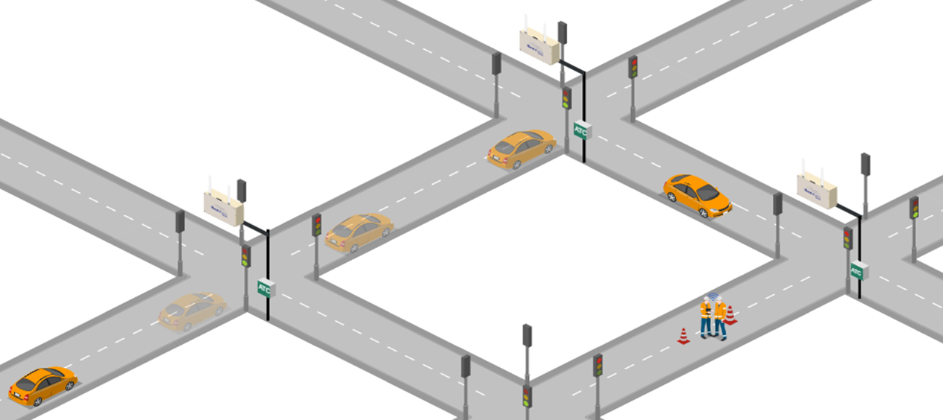
Concept Diagram
vRSU #2
RSU #2
vRSU #1
RSU #3
RSU #1
SEND NEW
POSITION TO CLOUD
RECEIVE DATA FROM
vRSU #3 AND WORK ZONE
SEND POSITION
TO CLOUD
SEND WORK ZONE LOCATION TO CLOUD
vRSU #3
RECEIVE DATA FROM
vRSU #1 AND vRSU #2

Slide 6




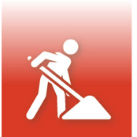
DANLAW Phone App Screen
Cloud
Link
Cloud
Link
Cloud
Link
RED LIGHT WARNING
WORK ZONE
AHEAD
12s
35s
35s
20s
2s
2s
12s
35s
35s

Slide 7


Coming Soon in Macomb County
300 Danlaw RSUs already installed and functional in Macomb
PILOT vRSU Cloud Project is going to be deployed in Macomb County

